Slide 1
Describing Quantitative Relationships:
Scatterplots and Correlation

Slide 2
Bivariate Data
When you collect two variables on one subject you get bivariate data e.g. heights and weights.
If both values are quantitative, you can make a scatter plot letting one variable be the explanatory variable and the other the response variable.

Slide 3
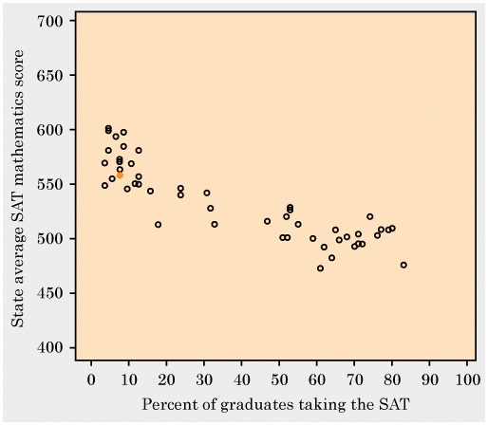
Scatter Plot Shows Relationship Between Two Quantitative Variables

Slide 4
Scatter Plot Shows Relationship Between Two Quantitative Variables
“Seeing Through Statistics”, Utts

Slide 5
Scatter Plots
A Scatter plot shows the relationship between two quantitative variables measured on the same individuals.
We think that one variable (the explanatory or x variable) explains the variation in values of the other variable (the response or y variable).
We think percent taking the SAT explains the variation in average SAT scores.
We think that distance of a putt explains the success rate.

Slide 6
Interpreting a Scatter Plot
Look for overall pattern and any striking deviations from that pattern.
In the overall pattern we look at the plots
Form – shape
Direction – positive or negative
Strength – strong or weak

Slide 7
Form, Direction, and Strength
Form- Is there a straight line relationship between the variables? Does the graph curve slightly or sharply either up or down? Can you see a pattern?
Direction: A pattern that runs from the upper left to the lower right has negative direction and a pattern that runs the other way has a positive direction.

Slide 8
Strength:
How much scatter is in the plot?
The less scatter the stronger the relationship between the variables. Graphs with a lot of scatter show a weak relationship between the points.

Slide 9
Interpreting a Scatter Plot
Form:
Direction:
Strength:

Slide 10
Interpreting a Scatter Plot
Form:
Direction:
Strength:

Slide 11
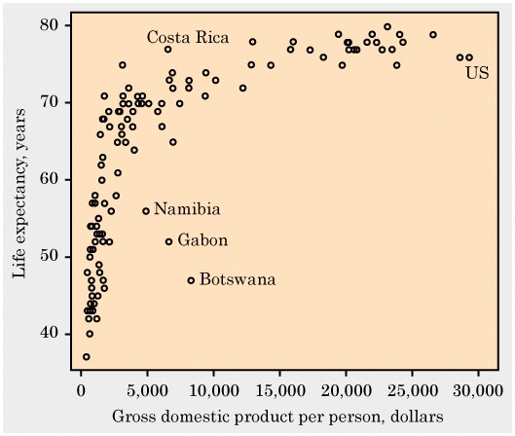
Interpreting a Scatter Plot
Form:
Direction:
Strength:

Slide 12
Regression and Correlation
We use regression analysis when prediction of the response variable, Y, from the explanatory variable X is desired.
(Note: Y depends on X)
We use correlation analysis when association between Y and X is under study.

Slide 13
Simple Linear Regression Model
The SIMPLE LINEAR MODEL relating Y and X is Y = b₀ + b₁X.
b₀ is the Y-INTERCEPT of the model, the point where the line crosses the Y-axis.
b₁ is the SLOPE of the model, the change in Y for a given unit change in X (“rise” over “run”).

Slide 14
Y = b₀ + b₁X
Y
∆Y = b₁
∆X = 1
b₀
X

Slide 15
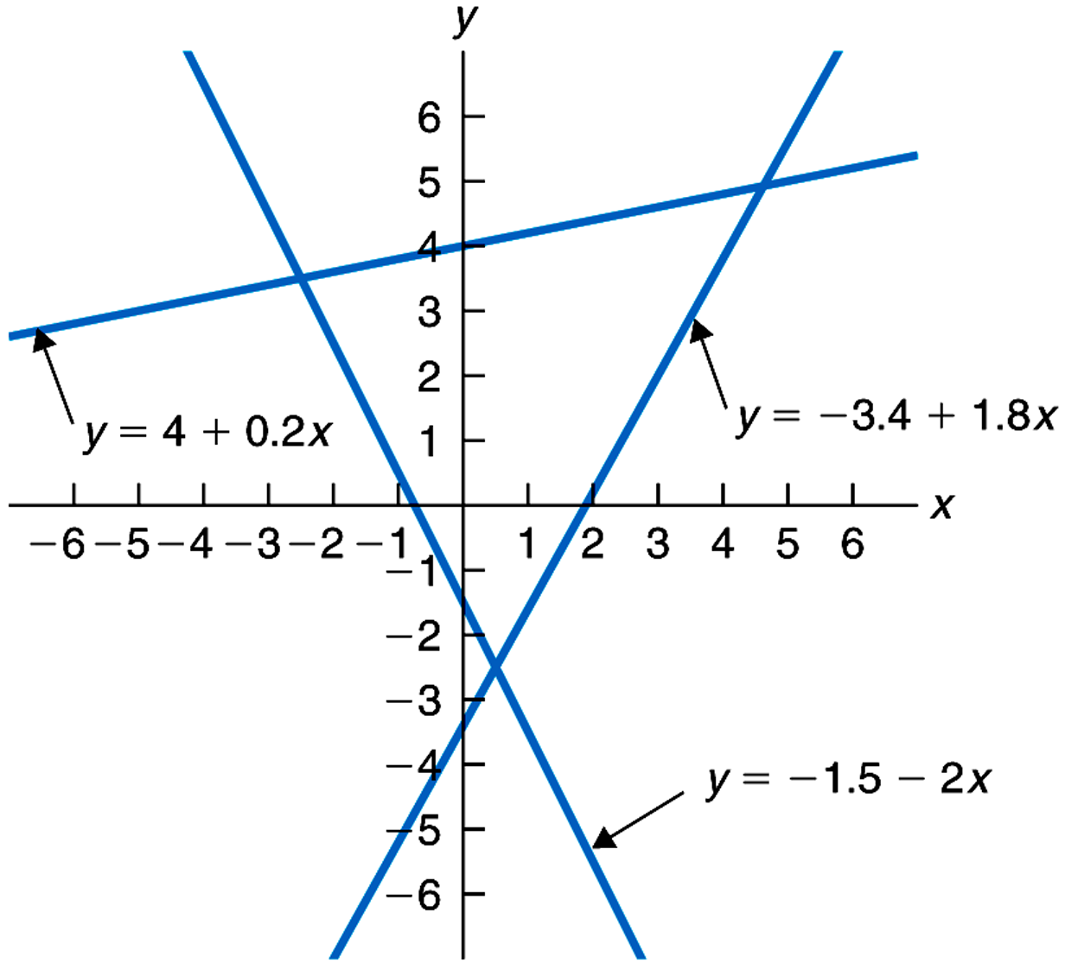
Straight-line graphs of three linear equations.

Slide 16
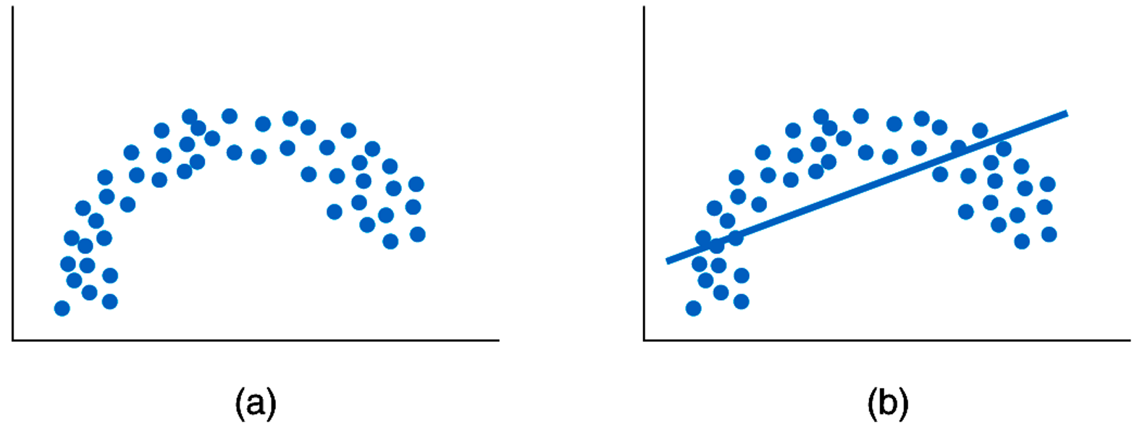
Always plot the scatter diagram to make sure the relationship between Y and X is linear. Otherwise your straight line may be nonsense!

Slide 17
The Least Squares Regression Line
This is obtained by minimizing the sum of the squared vertical differences between the data points and the regression line.

Slide 18
Deviations From the Line
+ deviations
- deviations

Slide 19
Coefficients of the Least Squares Line
Slope
Intercept

Slide 20
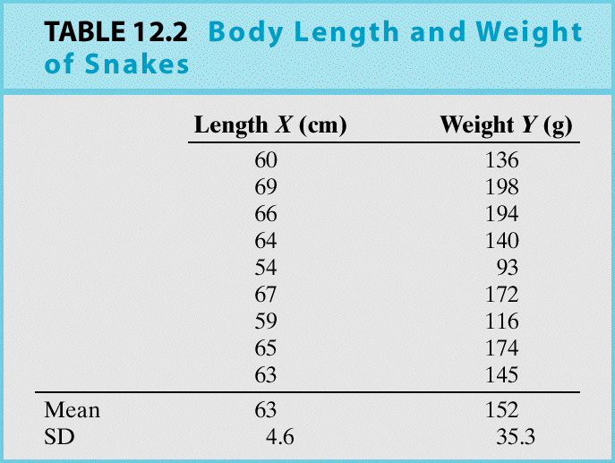
Example: can we predict the weight of a snake simply by measuring its length?
Y = snake weight (g) X = snake length (cm) Notice that the data appear as (x_{i},y_{i}) pairs:

Slide 21
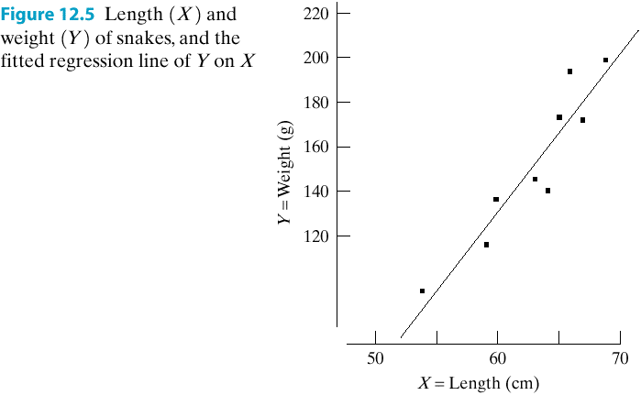
The snake data scatter plot shows a clear linear relation:

Slide 22
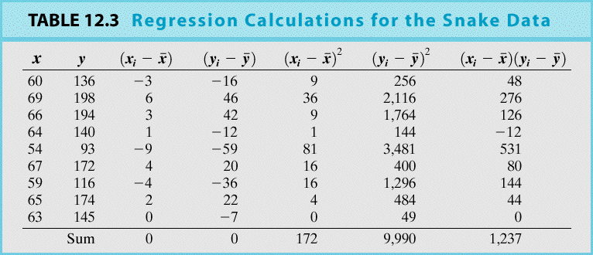
Table 12.3 summarizes the LS calculations:

Slide 23
Least Squares Coefficients
From the table we see
so that the LS coefficients are
b₁ = 1237/172 = 7.192 and
b₀ = 152 – (7.192)(63) = –301.096.
Thus, the LS line is Y = –301.096 + 7.192X.

Slide 24
Interpretation of LS coefficients:
b₁ = 7.192 indicates that a 1 cm increase in snake length leads to an estimated 7.192 g increase in snake weight.
b₀ is the estimated weight of a snake whose length is 0 cm. Clearly, this is a poor EXTRAPOLATION away from the bulk of the data.

Slide 25
Correlation shows the strength and direction of a linear relationship. It is measured by the Correlation Coefficient

Slide 26
Properties of r
1) -1 ≤ r ≤ +1
2) r = -1 represents perfect negative linear association.
3) r = +1 represents perfect positive linear association.
4) r = 0 represents no linear association.
(see plotted illustrations in next slide)

Slide 27
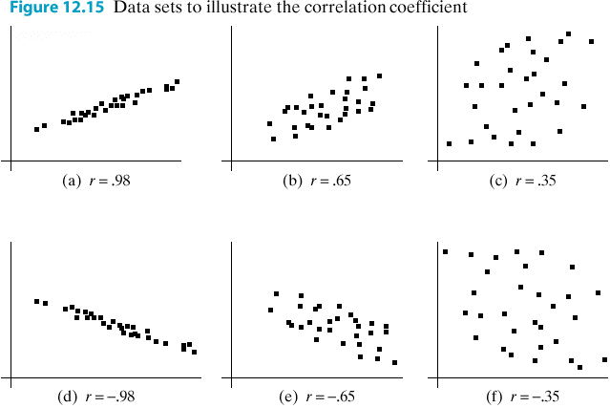

Slide 28
Example: Snake Data
r =
= 0.944
This indicates a high positive association between lengths and weights of snakes.

Slide 29
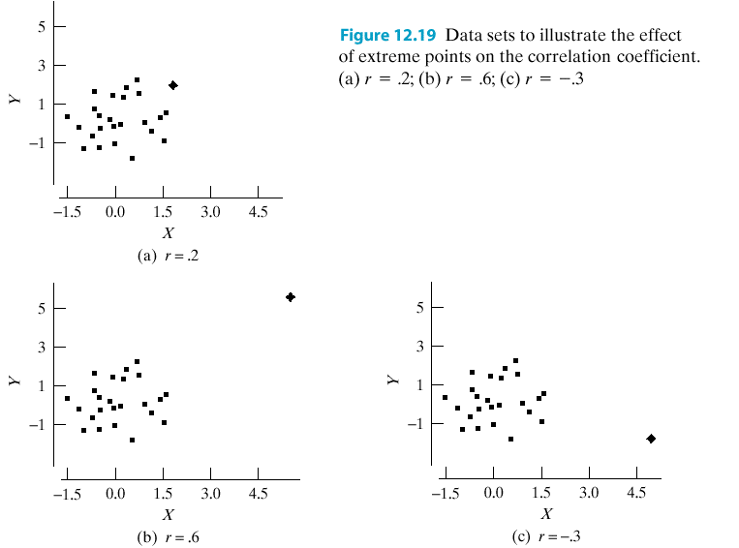
Beware: r is very sensitive to extreme observations

Slide 30
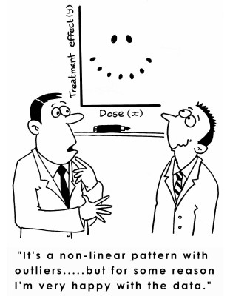

Slide 31
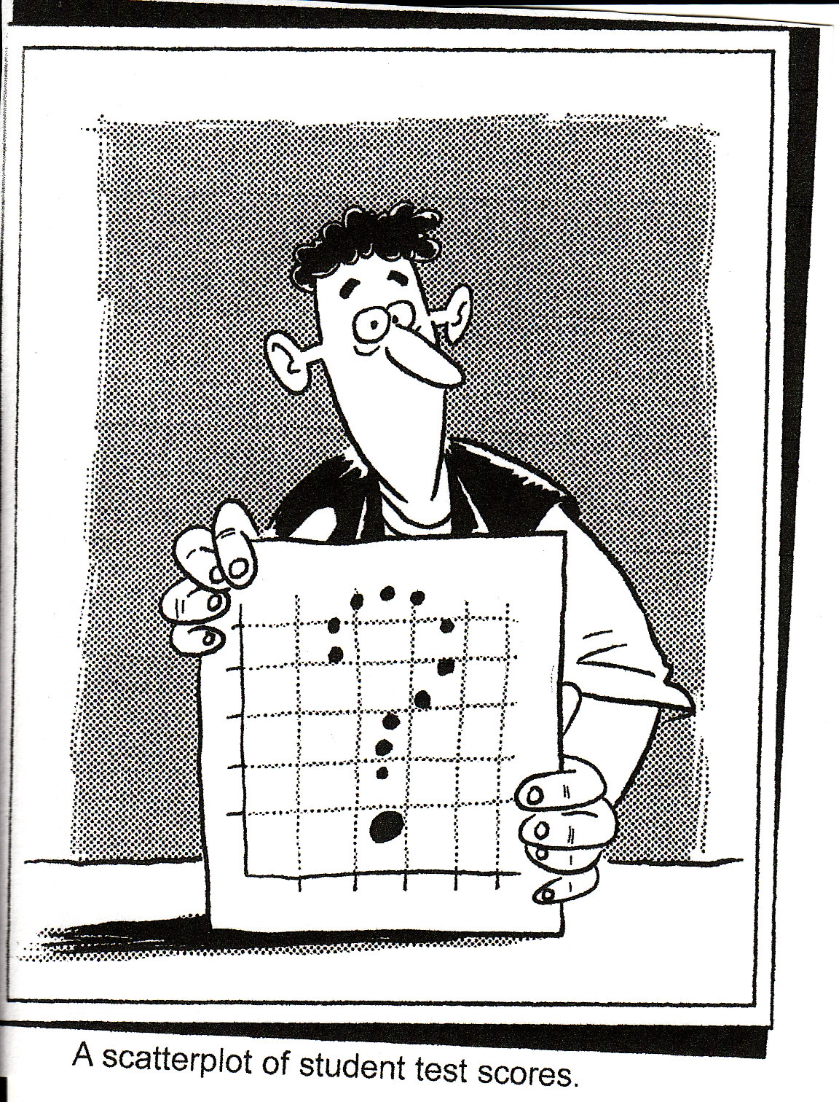

Slide 32
The Coefficient of Determination, r²
r² is the percentage of variation in the Y variable that is explained by the least squares regression on X.
r² has values between 0 and 100%

Slide 33
Example: Snake Data
r = 0.944
Hence r² = 0.8905
Hence 89% of the variation in snake weight is explained by variation in snake length.

Slide 34
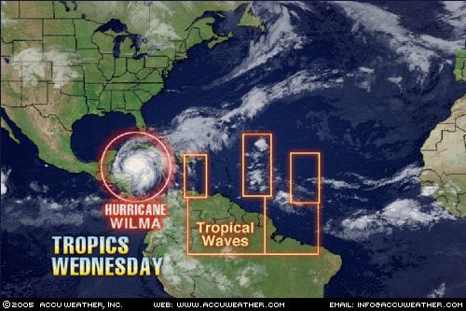
Hurricane Wilma

Slide 35
What is Central Pressure?
Central Pressure: The observed (or analyzed from peripheral pressure measurements) central pressure of the hurricane at landfall.
Maximum Winds: Estimated maximum sustained (1-min) surface (10 m) winds to occur along the U. S. coast. Winds are estimated to the nearest 10 knots for the period of 1851 to 1885 and to the nearest 5 knots for the period of 1886 to date.
(1 kt = 1.15 mph.)

Slide 36
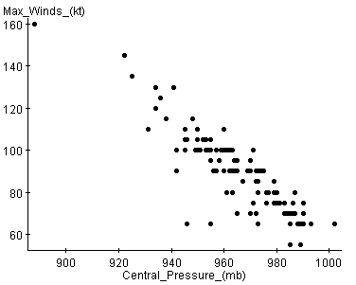
Scatter Plot (1851-2004)

Slide 37
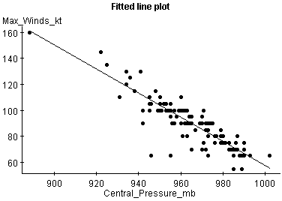
Least Squares Regression Line

Slide 38
Simple linear regression results:
Dependent (Y) Variable: Max_Winds_(kt) Independent (X) Variable: Central_Pressure_(mb)
Y = 985.15 - 0.93X
Sample size: 164
r (correlation coefficient) = -0.896
r² = 0.8028

Slide 39
What is the value for the slope and what does it mean?
slope = -.93
For every additional 1 mb. increase in central pressure, max wind speed deceases by .93 knots

Slide 40
What does r² tell us?
r² is the percent of variation of y accounted for by the least squares linear regression on x.
So 80% of the variability in max wind speed is accounted for by variation in central pressure.

Slide 41
Use this equation to predict the maximum wind speed for a central pressure of 882 mb.
Y = 985.15 - 0.93X
When X = 882,
Max_Winds = 166.89 knots
166.89 *1.15 = 191 mph !

Slide 42
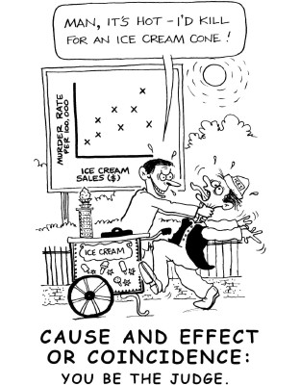

Slide 43
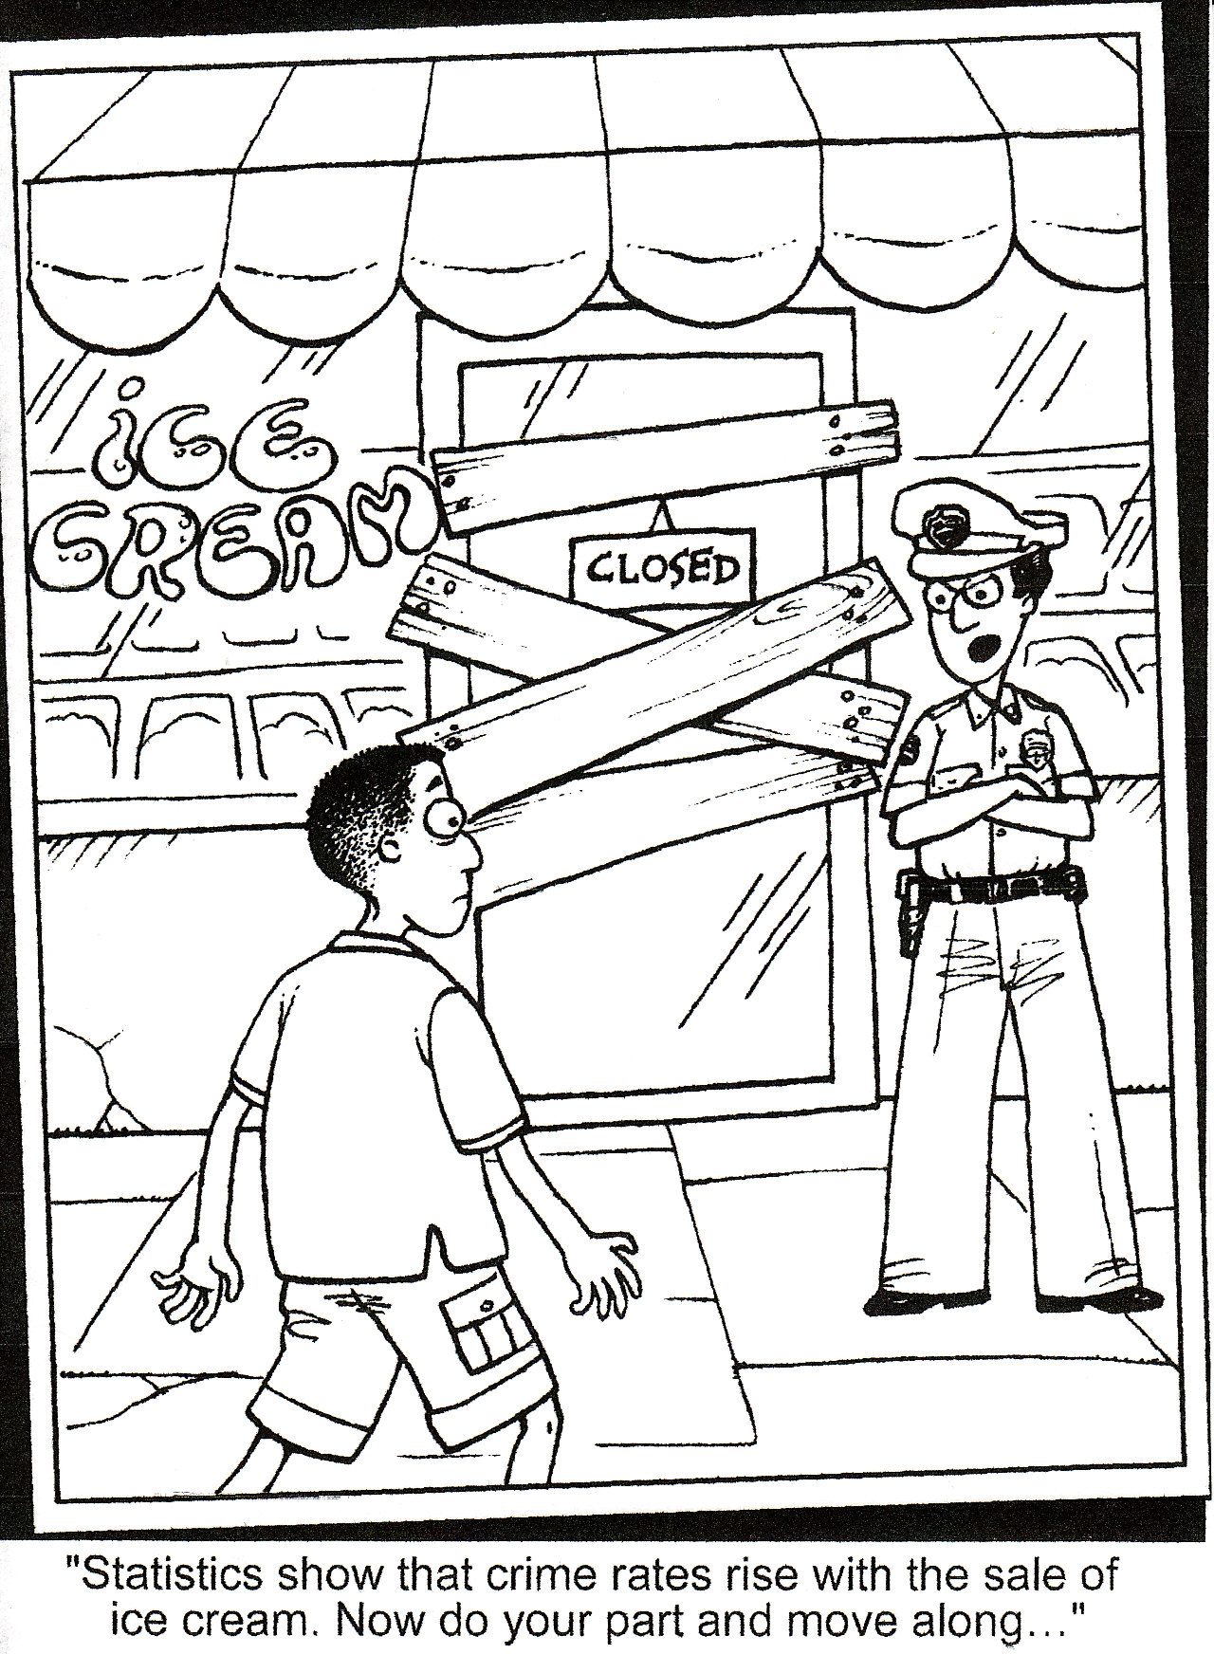

Slide 44


Slide 45
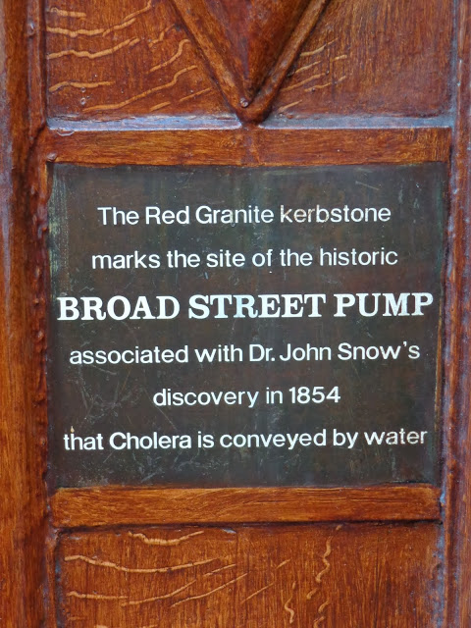

Slide 46


Slide 47
Correlation v Causation
Researching patterns of disease in British society in the 1840’s, William Farr tabulated Cholera deaths by elevation and concluded that higher ground was safer ground.
Cholera Deaths Elevation of the Community
Density of Settlement and
Access to Cleaner Water

Slide 48
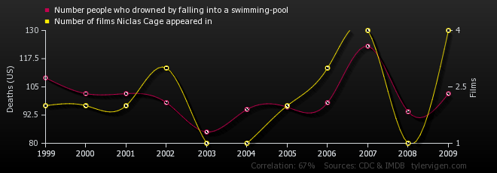
Spurious Correlations (r = 0.67)

Slide 49
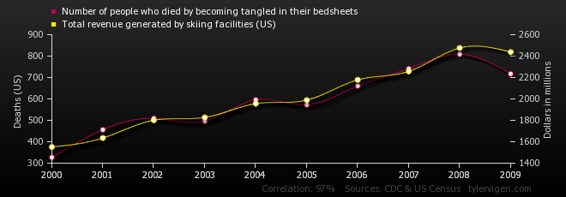
r = 0.97

Slide 50
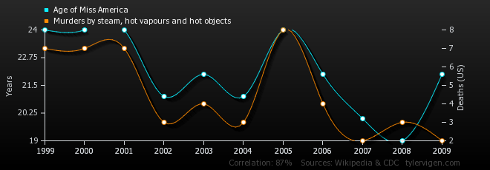
r = 0.87

